Slide 1
UCI DREAM Center
Dr. Angela Chen, Interim Director
Elisabet Barrios, Graduate Fellow

Slide 2
Presentation Goals
1. Think of migration as a human right
2. Address assumptions about undocumented people
3. Learn about the undocumented student population of UCI
4. Learn about the support services & programs of the DREAM Center
Notes:
Immigration policies are shaped by natural disasters, war, famine, and foreign policy.

Slide 3
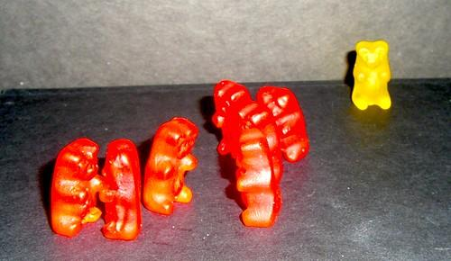
What do you see?
Notes:
Immigration policies are shaped by natural disasters, war, famine, and foreign policy.

Slide 4
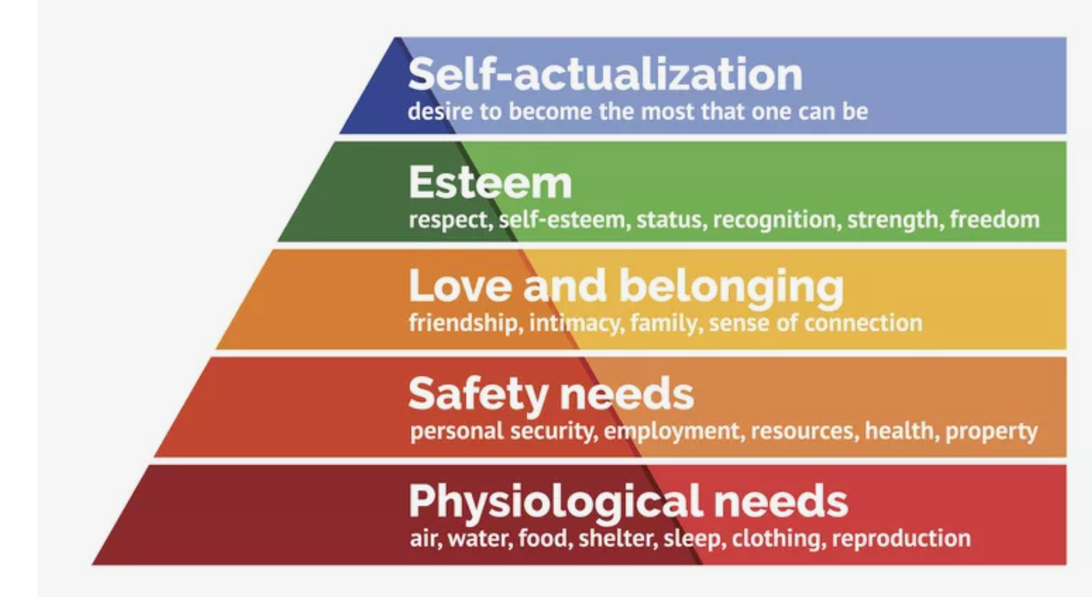
What are human needs?

Slide 5
Mobility is a human right
If the conditions in the place you call “home” were no longer conducive to survival (basic needs) and thriving (opportunity) what would you do?
Notes:
This question has been answered by many people across time. Ultimately, people want to live in prosperous and peaceful territories

Slide 6
TRUE or FALSE
Undocumented people have similar rights across the country
Education and health access vary greatly by state, as do policies around rental agreements and driving license.
In addition to state policies, there are layers of municipal and institutional policies that impact access

Slide 7
TRUE or FALSE
2. Incoming undocumented freshmen have DACA
So incoming freshmen are increasingly not DACA beneficiaries

Slide 8
TRUE or FALSE
3. Undocumented people work at UCI
If a person is undocumented but has work authorization, he/she/they can work at UCI

Slide 9
Shattering Polarizing Representations of Undocumented People
Notes:
Exceptional (heroic/American Dream) or Criminal (villain/threat)

Slide 10
“Illegality” has been racialized in the U.S.
Targets of deportation
Targets of support initiatives

Slide 11
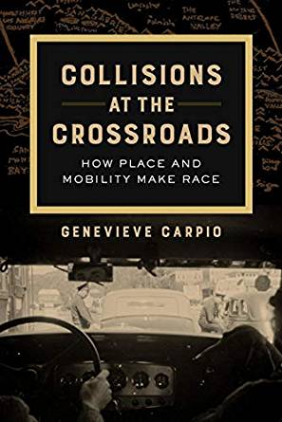
“Illegality” has been racialized in the U.S.

Slide 12
DREAM Center History
Undocumented Student support services started in 2013 when UCI’s Student Outreach and Retention Center (SOAR) began an undocumented student program. Soon, the university realized that more resources were needed and in summer of 2017 the DREAM center was created due to the significant growth in the undocumented student population.

Slide 13
DREAM Center Mission Statement
The UCI DREAM Center stands with and serves those impacted by immigration policy through advancing systemic change, deconstructing oppressive policies, and fostering community. We work towards personal growth, collective healing, and visible change.

Slide 14
DREAM Center Statistics

Slide 15
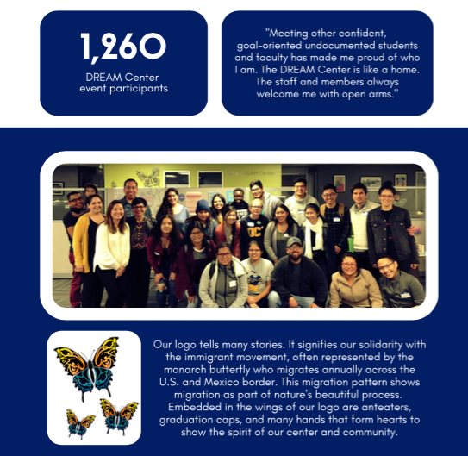

Slide 16
DREAM Center Programs and Services
Mental Health Counseling Referral
Legal Services Counseling Referral
Art Collective
Graduate School Workshops
Housing Placement
Scholarships/Fellowships
Conference

Slide 17
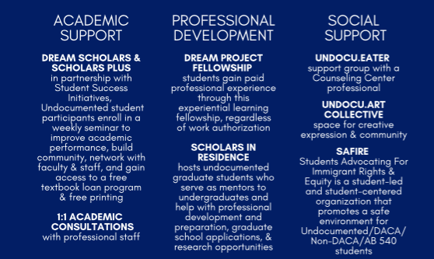

Slide 18
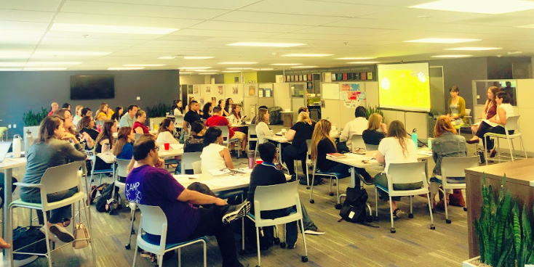
UndocuAlly Training
December 6, 2019 from 9 am - 3 pm

Slide 19
Thank you
Check out our website (different from the OIE pamphlet):
https://dream.uci.edu/
Follow us on Instagram:
@ucidreamcenter

Slide 20
We are a support system for each other

